Slide 1
Chapter 6 Limited Direct Execution
Chien-Chung Shen
CIS/UD
cshen@udel.edu

Slide 2
Mindset
Empty yourself (meditate 😌)
Pretend that you were the first person being asked to design “something” to make a better use of a “bare” computing machine (CPU + memory)

Slide 3
Introduction
Virtualize (physical) CPU via “time” sharing
Two challenges to such mechanism
performance – with minimum overhead
control – retain control of CPU while running processes efficiently
➔ Obtaining high performance while maintaining control is the key challenge in building OS
Need hardware support (how much?)
one “mode” bit (user vs. kernel mode)
Technique: Limited Direct Execution
Notes:
----- Meeting Notes (2/10/16 17:01) -----
39339

Slide 4
Direction Execution without Limits
OS Program
create an entry in process table
allocate memory for process
load program into memory
set up stack with argc/argv
clear registers
execute “call main()”
run main()
execute return from main()
free memory of process
remove from process list
Direct execution mean running the program directly on the CPU
One problem?
what happens when the program runs forever?

Slide 5
Limited Direct Execution
“Direct Execution” – run programs directly on the CPU
Two issues
#1 if we just run a program, how can OS make sure the program doesn’t do anything that we don’t want it to do, while still running it efficiently?
#2 when we are running a process, how does OS stop it from running and switch to another process (i.e., how does OS implement time sharing)?
Without “limits on running programs,” the OS would not be in control of anything

Slide 6
#1 Restricted Operations
Advantage of direct execution:
fast - program runs natively on hardware CPU and thus executes as quickly as one would expect
Issues
what if the program never stops?
what if the process wishes to perform “restricted” operations (e.g., I/O requests or accessing more resources [e.g., memory])?

Slide 7



How to Perform Restricted Operations?
A user process must be able to perform I/O and other restricted operations, but without giving the process complete control over the system
Customers (user processes) ask the teller (system calls of OS) to perform restricted operations on their behalf
Both customer and teller are software programs; how does CPU tell the difference?
hardware mode bit facilitating protected control transfer

Slide 8

Protected Control Transfer
Hardware Mode Bit in CPU
Operating System

Slide 9
Protected Control Transfer
Hardware assists OS by providing different modes of execution via the mode bit to dedicate processor mode
user mode - applications do not have full access to hardware resources (e.g., cannot issue I/O requests; otherwise raising an exception)
kernel mode – OS can do anything and has access to the full resources of the machine
Issue?
what should a user process do when it wishes to perform privileged operation, such as open a file or read from a file?
Perform system calls

Slide 10
System Calls
Allow kernel to carefully expose certain key pieces of functionalities (access files, create process, IPC, etc.) to user programs
Inside each system call function is a trap (assembly) instruction which simultaneously jumps into kernel and raises the privilege level to “kernel” mode (set the mode bit to K)
save enough of caller’s registers in order to return correctly when OS issues return-from-trap instruction [push program counter, flags, and a few other registers onto a per-process kernel stack]
Once inside kernel, privilege instructions can be executed
When finished, OS calls a special return-from-trap (assembly) instruction, which returns into the calling user program while simultaneously reducing the privilege level back to “user” mode [pop these values off the stack and resume execution of the user-mode program]

Slide 11
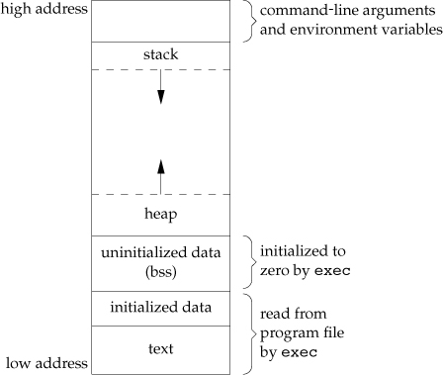
Unix Process Memory Layout
Process has 4 segments
text – lowest addresses, fixed size
data – immediately after text for global variables
stack – store “automatic variables” with function calls
heap - gap in the middle for dynamic memory allocation via malloc()
a.out
Stevens & Rago’s Fig. 7.6

Slide 12
Stack
void A(int tmp) {
if (tmp == 2) return;
else B();
}
void B(){
C();
}
void C(){
A(2);
}
main(){A(1);}
Stack
main()

Slide 13
Stack
void A(int tmp) {
if (tmp == 2) return;
else B();
}
void B(){
C();
}
void C(){
A(2);
}
main(){A(1);}
Stack
main()
A(1)

Slide 14
Stack
void A(int tmp) {
if (tmp == 2) return;
else B();
}
void B(){
C();
}
void C(){
A(2);
}
main(){A(1);}
Stack
main()
A(1)
B()

Slide 15
Stack
void A(int tmp) {
if (tmp == 2) return;
else B();
}
void B(){
C();
}
void C(){
A(2);
}
main(){A(1);}
Stack
main()
A(1)
B()
C()

Slide 16
Stack
void A(int tmp) {
if (tmp == 2) return;
else B();
}
void B(){
C();
}
void C(){
A(2);
}
main(){A(1);}
Stack
main()
A(1)
B()
C()
A(2)

Slide 17
Stack
void A(int tmp) {
if (tmp == 2) return;
else B();
}
void B(){
C();
}
void C(){
A(2);
}
main(){A(1);}
Stack
main()
A(1)
B()
C()

Slide 18
Stack
void A(int tmp) {
if (tmp == 2) return;
else B();
}
void B(){
C();
}
void C(){
A(2);
}
main(){A(1);}
Stack
main()
A(1)
B()

Slide 19
Stack
void A(int tmp) {
if (tmp == 2) return;
else B();
}
void B(){
C();
}
void C(){
A(2);
}
main(){A(1);}
Stack
main()
A(1)

Slide 20
Stack
void A(int tmp) {
if (tmp == 2) return;
else B();
}
void B(){
C();
}
void C(){
A(2);
}
main(){A(1);}
Stack
main()

Slide 21
System Calls
.global write;
write:
movl $16, %eax;
int $64;
ret
Special instructions to
at boot time, allow OS to tell the hardware where the trap table resides in memory
“trap” into the kernel and “return-from-trap” back to user-mode programs
trap : simultaneously jumps into kernel, sets mode bit to K, and switch to use kernel stack
system call #
From Operating Systems in Depth, Fig. 3.5, by Thomas Doeppner
(per process)

Slide 22
System Call
A system-call number is assigned to each system call
The user-facing system call function is thus responsible for placing the desired system-call number in a register (%eax) or at a specified location on the stack, and then “traps” into kernel
The OS, when handling the system call inside the trap handler, examines this number, ensures it is valid, and, if it is, executes the corresponding code of system call
This level of indirection serves as a form of protection; user code cannot specify an exact address to jump to, but rather must request a particular service via system call number
.global write;
write:
movl $16, %eax;
int $64;
ret

Slide 23
Two Stacks Per Process
When a process is running in user mode, its kernel stack is empty
When a process has been preempted (by timer) [ready but not running], its kernel stack contains the user-level processor state at the point when the user process was interrupted (i.e., the state to be restored when the process is resumed)
When a process is inside a system call waiting for I/O
its kernel stack contains the context to be resumed when the I/O completes
its user stack contains the context to be resumed when the system call returns

Slide 24
Implementation of System Calls
Setup trap table (interrupt vector) at boot time
tell hardware what code to run when exceptional events occur, e.g., hard-disk interrup, keyboard interrupt, system call, etc.
trap instruction
simultaneously jump into kernel; raise privilege level to kernel mode; push (save) caller’s registers (e.g., PC, SP, etc.) onto per-process kernel stack
return-from-trap instruction
simultaneously return to calling program; reduce privilege level to user mode; pop registers (e.g., PC, SP, etc.) off per-process kernel stack

Slide 25
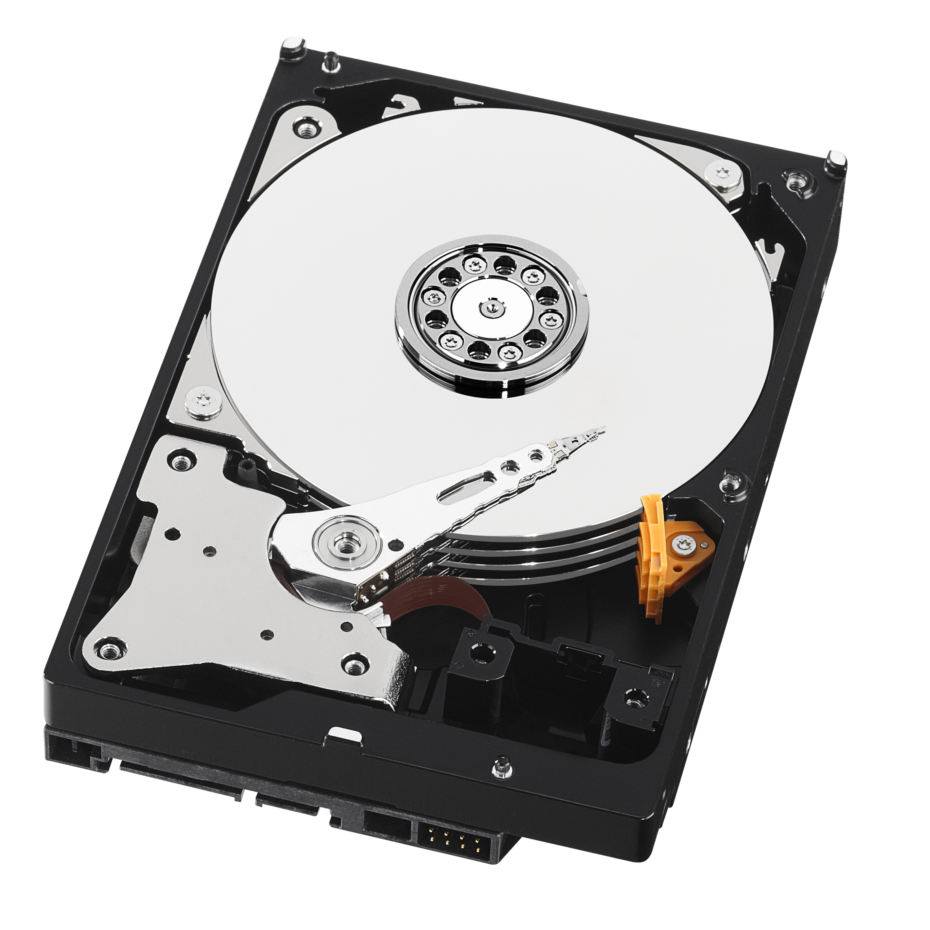
System Call
user stack
kernel stack
disk_driver()
When a process is inside a system call waiting for I/O
its kernel stack contains the context to be resumed when the I/O completes
its user stack contains the context to be resumed when the system call returns

Slide 26
State before an interrupt handler is invoked
SS: stack segment; ESP: stack pointer
CS: code segment; EIP: program counter (PC)
EIP and ESP refer to locations in user process
interrupt (kernel) stack is empty
X86 is “segmented” so each segment (code, data, stack) has two parts: base + offset

Slide 27
???
pushed by hardware
State after x86 hardware has “jumped to” the interrupt handler
Hardware pushed the user context on the interrupt (kernel) stack and changes the program counter and stack pointer to locations in kernel memory (and push Error code if necessary)

Slide 28
State after the interrupt handler has started executing
The handler first saves (pushad) the current state of the processor (general) registers, since it may overwrite them
this saves stack pointer twice: first, the user stack pointer then the kernel stack pointer

Slide 29
.global read;
read:
movl $5, %eax;
int $64;
ret
.global write;
write:
movl $16, %eax;
int $64;
ret
.global fork;
fork:
movl $1, %eax;
int $64;
ret

Slide 30
Why System Calls Look Like Procedure Calls?
You may wonder why a call to a system call, such as open() or read(), looks exactly like a typical procedure call in C; that is, if it looks just like a procedure call, how does the system know it’s a system call, and do all the right stuff? The simple reason: it is a procedure call, but hidden inside that procedure call is the famous trap instruction. More specifically, when you call open() (for example), you are executing a procedure call into the C library. Therein, whether for open() or any of the other system calls provided, the library uses an agreed-upon calling convention with the kernel to put the arguments to open() in well-known locations (e.g., on the stack, or in specific registers), puts the system-call number into a well-known location as well (again, onto the stack or a register), and then executes the aforementioned trap instruction. The code in the library after the trap unpacks return values and returns control to the program that issued the system call. Thus, the parts of the C library that make system calls are hand-coded in assembly, as they need to carefully follow convention in order to process arguments and return values correctly, as well as execute the hardware-specific trap instruction. And now you know why you personally don’t have to write assembly code to trap into an OS; somebody has already written that assembly for you.

Slide 31
Where to Go When Trap?
How does the trap know which code to run inside OS?
the calling process can’t specify an address to jump to (as you would when making a function call)
doing so would allow programs to jump anywhere into the kernel – a Very Bad Idea
Kernel sets up a trap table at boot time
when machine boots up, it is in kernel mode, and tells hardware what code (addresses of the code) to run when certain exceptional events occur. E.g., what code should run
when a hard-disk interrupt takes place; when a keyboard interrupt occurs; when a program makes a system call, etc.
kernel informs hardware of the locations (addresses) of these trap handlers via special privileged instructions
Hardware trapping mechanism

Slide 32
Trap Table/Vector (IDT)
How does trap know which code to run inside the OS?
can a calling process specify an address to jump to?
of course not!
kernel must carefully control what code executes upon a trap (with a #)
Setup trap table/vector (interrupt descriptor table [IDT]) at boot time
when machine boots up, it does so in privileged (kernel) mode, and thus is free to configure machine hardware as need be
OS tells hardware what code to run when certain exceptional events occur (e.g., hard disk interrupt, keyboard interrupt, system call, exception, etc.)

Slide 34
# vector table
.data
.globl vectors
vectors:
.long vector0
.long vector1
.long vector2
...
.long vector255
# handlers
.globl alltraps
.globl vector0
vector0:
pushl $0
pushl $0
jmp alltraps
.globl vector1
vector1:
pushl $0
pushl $1
jmp alltraps
.globl vector2
vector1:
pushl $0
pushl $2
jmp alltraps
...
.globl vector255
vector255:
pushl $0
pushl $255
jmp alltraps
Trap/interrupt entry points:
one entry point per interrupt number
vectors.S
generated from
vectors.pl

Slide 36
inform hardware of trap vector

Slide 37
load interrupt descriptor table register:
inform hardware of trap vector

Slide 38
Implementation in xv6
syscall.h syscall.c
Array of function pointers to system call functions

Slide 39
Implementation in xv6
system call number saved in %eax
.global write;
read:
movl $16, %eax;
int $64;
ret

Slide 40
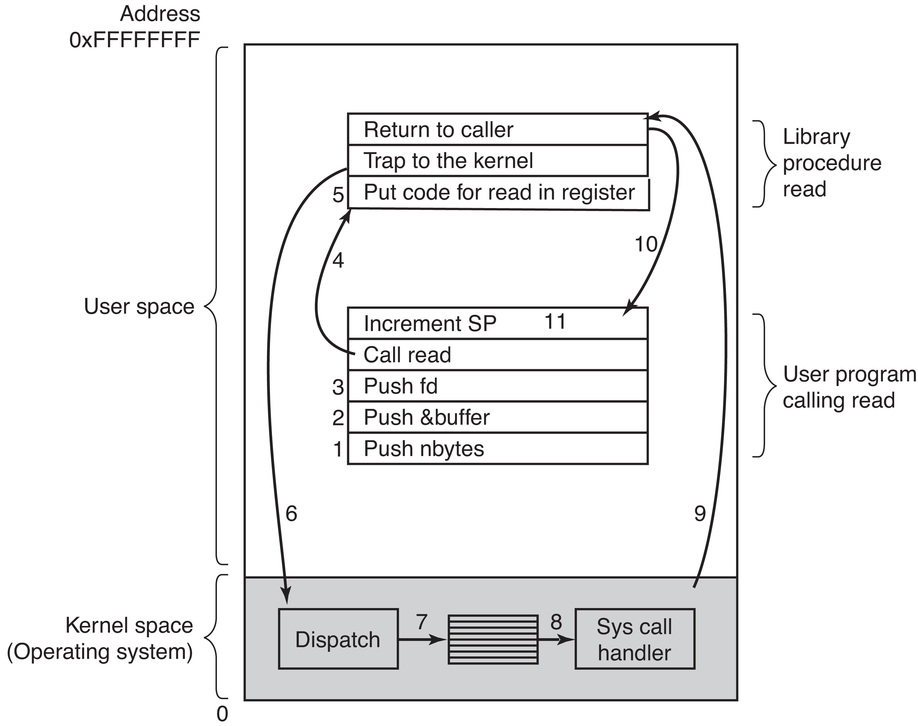
System Call
count = read(fd, buffer, nbytes);
system call #
(pop)
From Modern Operating Systems, 4th edition, Fig. 1-17, by Tanenbaum and Bos
[U➔K]

Slide 41
Limited Direct Execution
time
Phase 1
initialize trap table
Phase 2
process creation

Slide 42
#2 Switching between Processes
When one process is running on CPU, OS is not running
➔if OS is not running, how can it do anything at all?
How can OS regain control of CPU so it can switch from one process to another?
cooperative approach – OS trusts processes, and a process gives up CPU (1) frequently by making system calls, (2) periodically by calling yield() system call, or (3) does something illegal (illegal memory access) to trap into OS
what about infinite loop?
non-cooperative approach: OS takes control, but how?
need hardware support – timer interrupt

Slide 43
(Timer) Interrupts
At boot time
OS informs hardware of which code to run when (timer) interrupts occur
OS starts the timer (a privileged operation)
When hardware interrupt occurs, the currently running process is halted, and a pre-configured interrupt handler in the OS runs. At this point, the OS regains control of the CPU
hardware saves the context (machine state) of the currently running process [onto kernel stack] such that a subsequent return-from-trap instruction could restore the state to resume its execution

Slide 44
Context Switch
OS regains control of CPU cooperatively via (yield) system call or forcefully via timer interrupt
Scheduler decides which process to run next
Context switch
save context – (execute assembly code) to save PC, registers, and kernel stack pointer of the “currently-running” process onto its kernel stack
restore context – (execute assembly code) to restore PC, registers, and kernel stack pointer from the kernel stack of the “soon-to-be-executing” process
return-from-trap (resume execution of the other process)
By switching stacks, kernel enters the switch() code in the context of one process (the one that was interrupted) and returns in the context of another (the soon-to-be-executing process) when executing return-from-trap

Slide 45
LDE with Timer Interrupt
time
Two types of register save and restore
when timer interrupt occurs – user registers of running process are implicitly saved by hardware into kernel stack of the process
when OS decides to switch process – kernel registers are explicitly saved by OS software into PCB of process

Slide 46
Context Switching
Two types of register saves/restores
when timer interrupt occurs (trap), user registers of the running process (A) are implicitly saved by hardware into the kernel stack of A → trap into kernel
execute Kernel’s timer interrupt handler which decides to switch from process A to process B
call switch() so that kernel registers of A are explicitly saved by software (i.e., the OS/kernel itself) into memory in the process structure (PCB) of process A
restore kernel registers of B from B’s PCB
change “stack pointer” to use B’s kernel stack (switch context)
OS returns-from-trap → restore B’s registers (resume from B’s kernel stack) and start running B (from B’s PC)
moves the system from running as if it just trapped into the kernel from A to as if it just trapped into the kernel from B
Kernel enters switch() in the context of the interrupted process and returns in the context of another process

Slide 48

old new

Slide 49
Concurrency
What happens when a timer interrupt occurs during a system call?
What happens when an interrupt occurs during the handling of an earlier interrupt?
Two possible solutions
disabling interrupts during interrupt processing
locking to protect concurrent access to internal kernel data structures

Slide 50
Unix and Kernel Stack
In the original implementation of UNIX, kernel memory was at a premium; main memory was roughly one million times more expensive per byte than it is today
The initial system could run with only 50KB of main memory
Instead of allocating an entire interrupt stack per process, Unix allocated just enough memory in the process control block to store the user-level registers saved on a mode switch
In this way, Unix could suspend a user-level process with the minimal amount of memory
Unix still needed a few kernel stacks: one to run the interrupt handler and one for every system call waiting for an I/O event to complete, but that is much less than one for every process
Now that memory is much cheaper, most systems keep things simple and allocate a kernel stack per process or thread

